Slide 1
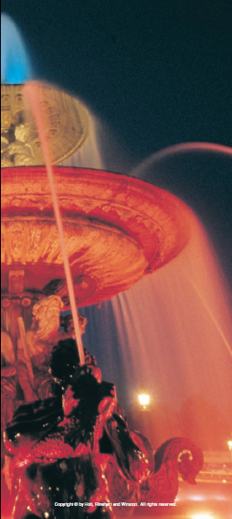
Chapter 3

Slide 2
Adding vectors that are not perpendicular
So far, the vector addition problems have all used vectors that are perpendicular to each other (make right triangles)
However, many objects move in one direction and then turn at an acute angle before continuing their motion

Slide 3
Adding vectors that are not perpendicular
When the original displacement vectors do not form a right triangle, you cannot directly use the trigonometry formulas
Instead, we have to find the components for each original vector

Slide 4
Adding vectors that are not perpendicular
Once you have the components of the original vectors, they can be added
The vector sums then are used to find the resultant

Slide 5
Angle Directions
East of North
West of North
North of West
North of East
South of West
South of East
East of South
West of South

Slide 6
Example
A hiker walks 25.5 km from her base camp at 35° south of east. On the second day, she walks 41.0 km in a direction 65° north of east, at which point she discovers a forest ranger’s tower. Determine the magnitude and direction of her resultant displacement between the base camp and the ranger’s tower.

Slide 7
Steps to Solving
Draw a picture and label everything.
Remember that each triangle has 4 variables.
Find x and y for the first two triangles.
Add or subtract your x’s and y’s to find the x and y for triangle 3.
Solve for d.
Solve for Θ. Remember to include the directional terms.

