Slide 1
Electric Forces and Fields Pgs. 628-653

Slide 2
Electric Charge
Two kinds of electric charges
Positive
Negative

Slide 3
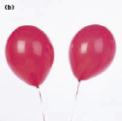
Unlike charges attract Like charges repel

Slide 4
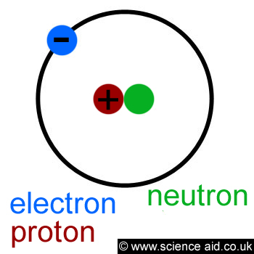
Electric charges are conserved
No charge is destroyed or created
In an atom:
Electrons are gained or lost making the atom charged – called ions

Slide 5
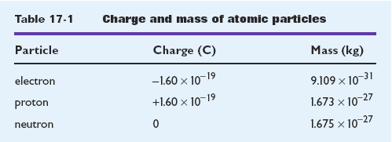
Electric charge is quantized
Charge occurs as discrete amounts in nature
Charge is always a multiple of a fundamental unit of charge
Symbol for charge is q (sometimes use e)
SI unit for charge is the coulomb (C)

Slide 6
Transfer of Electric Charge
Conductors
Materials that transfer charge freely
Ex. metals
Insulators
Materials that do not transfer charge easily
Ex. glass, rubber, cloth, plastic

Slide 7
Semiconductors
Materials that fall between conductors and insulators
In their pure state – insulators
When specific atoms are added – increased ability to conduct charge
Superconductors
Perfect conductors when they are at or below certain temperatures

Slide 8
Three ways to charge conductors and insulators
1. Charged by contact
materials must be touching to transfer charge
2. Charged by induction
Induction – process of charging a conductor by bringing it near another charged object and grounding the conductor

Slide 9
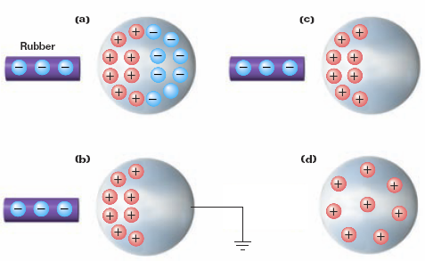

Slide 10
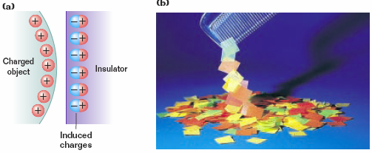
3. Charged by polarization
Polarization – in the presence of a charged object, the centers of charge in an insulator are realigned
This realignment of charge allows an object with a net charge of zero to attract or repel objects

Slide 11
Charged objects exert a force on each other (Electric Force)
The closer two charges are, the greater the force between them
The force between two charges is proportional to the product of the two charges
Electric force is inversely proportional to the square of the distance between two charges
Electric Force is a field force

Slide 12
k_{C} =8.99 x 10⁹ N•m²/C²

Slide 13
The electron and proton of a hydrogen atom are separated, on average, by a distance of 5.3 x 10⁻¹¹ m. Find the magnitude of the electric force.

Slide 14
The electron and proton of a hydrogen atom are separated, on average, by a distance of 5.3 x 10⁻¹¹ m. Find the magnitude of the electric force.

